Slide 1
Going from TouchDevelop to Cortex-M0: the BBC micro:bit And making sure $(CPP) does all the work!
J. Protzenko
Microsoft Research

Slide 2
Some background (1)
BBC has a “Make it Digital” campaign this year
Goal: distribute 1 million devices to kids (11/12-year olds)
Variety of partners
Microsoft (programming environment)
ARM / Farnell (device)
U. of Lancaster (C++ runtime system)
Samsung (Android app)

Slide 3
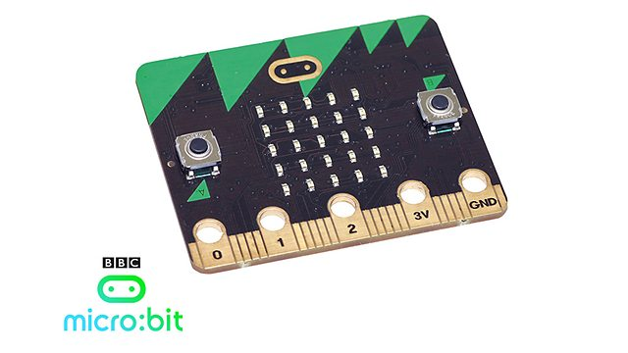
A picture!

Slide 4
Some background (2)
The goal: introduce the CS curriculum using a fun & simple device
Support from Computer At School (CAS) association
Goal: engage teachers, parents, kids

Slide 5
Client Computer
Web browser
TouchDevelop program
USB
1
Drive
User codes TouchDevelop
program and presses “compile” button
Compiler
1
TouchDevelop
C++
3
User drags ARM binary
to drive for Micro Bit
C++ program
ARM binary
Compiler
2
C++
mbed C++ SDK
ARM
2
User accepts download
of ARM binary
mbed compile service
ARM binary
Azure

Slide 6
TouchDevelop-the-language
Syntax-directed editor, JavaScript-inspired
Statically type-checked
Garbage-collected
Closures (capture-by-value, à la JavaScript)
Does not prevent uninitialized values (run-time errors)
Everything happily mutually-recursive
Primitive support for “libraries”

Slide 7
Compiling to C++: a good idea?
Option #1: write an interpreter on the device
Option #2: run the byte-code compiler in the browser and run a byte-code interpreter on the device
Option #3: write our own compilation toolchain 😸
As often happens, constraints on time and engineering resources led us into Option #4.

Slide 8
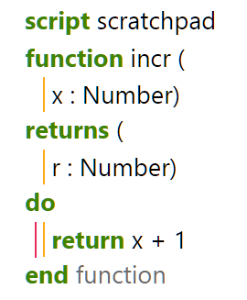
Types and variables (1)
TouchDevelop program
Generated code
Number incr(Number x) {
return number::plus(x, 1);
}
typedef int Number;
typedef bool Boolean;
typedef ManagedString String;
typedef void (*Action)();
Hand-written glue

Slide 9
Types and variables (2)
Generate human-readable, valid C++ identifiers
Wrap everything in a namespace (to limit pollution)
Fill out definitions for types (typedef) and functions
That’s the basic idea.

Slide 10
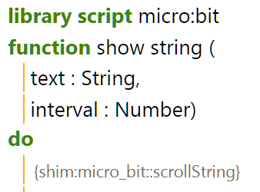
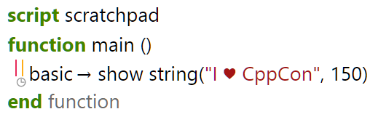
« Shimming »
{shim:…} annotations: can be referenced, but no implementation generated
void main() {
micro_bit::scrollString(
touch_develop::mk_string(
"I ♥ CppCon"), 150);
}

Slide 11


Memory management
We went for ref-counting (why?)
Now, advanced scenarios can create cycles (that’s too bad)
Custom ref-counting class (why? why?!!)
memory leak on copy assign of an 'empty' object created with the default constructor so 'now' was being created with no value, but had a reference counter. the subsequent line assigned a value, and adopted a new reference counter, but never freed the old one.
std::shared_ptr!

Slide 12
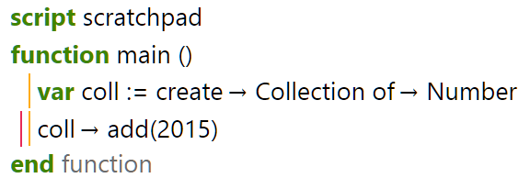
Built-in library types
void main() {
Collection<Number> coll;
coll = create::collection_of<Number>();
collection::add(coll, 2015);
}
#if __cplusplus > 199711L
template <typename T> using Collection = ManagedType<vector<T>>;
namespace create {
template<typename T> Collection<T> collection_of() {
return ManagedType<vector<T>>(new vector<T>());
}
#endif

Slide 13
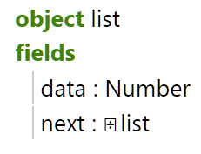
User-defined types (1)
namespace user_types {
struct list_;
typedef ManagedType<list_> list;
// …
// every other type definition in the current program
}
namespace user_types {
struct list_ {
Number data;
user_types::list next;
};
}

Slide 14
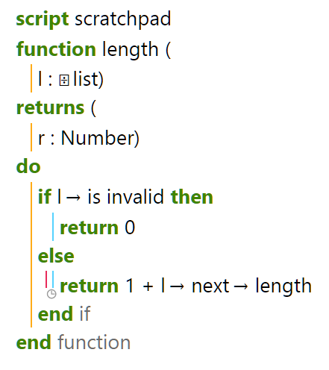
User-defined types (2)
Number length(user_types::list l) {
if (list::is_invalid(l)){
return 0;
} else {
return number::plus(
1,
length((l.get() != NULL ? l->next : (uBit.panic(…), l->next))));
}
}

Slide 15
Recursion hell
namespace user_types {
struct list_;
typedef ManagedType<list_> list;
// more here…
}
namespace my_library {
namespace user_types {
// more here…
}
}
namespace user_types {
struct list_ {
// …
};
// more here…
}
namespace my_library {
namespace user_types {
// more here…
}
}
Global compilation, every time
Within a “library”;
Functions are mutually recursive
Types are mutually recursive
They can have the same name
“Libraries” are not mutually recursive
Each library is wrapped in a C++ namespace
Can reference types/functions from other libraries
Number length(user_types::list l);
// more here…
namespace my_library {
// more here…
}
Number length(user_types::list l) {
// …
}
// more here

Slide 16
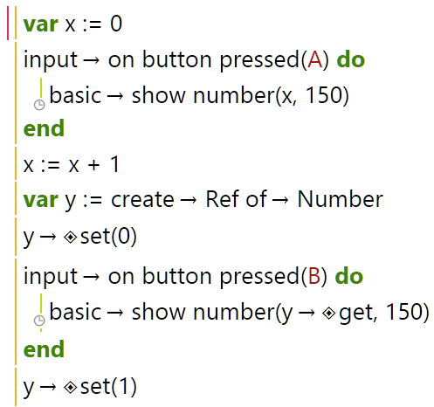
Closures!
Implement closure-conversion? Oh noes!
Better use C++11!

Slide 17
Closures! (2)
Ref<Number> y;
y = create::ref_of<Number>();
ref::_set(y, 0);
auto _body_0_ = [=] () -> void {
micro_bit::scrollNumber(ref::_get(y), 150);
};
auto _body_0 =
new std::function<void ()>(_body_0_);
micro_bit::onButtonPressed(
MICROBIT_ID_BUTTON_B, _body_0);
ref::_set(y, 1);

Slide 18
Closures (3)
Closures that do not capture anything are lifted
Closures that do capture currently not implemented due to bad semantics
The “ARMCC” killer. (GCC it is, now – just 300k wasted SRAM.)

Slide 19
Looking forward
C++: as usual, a high-level language for low-level targets
Generic translation; repurpose for Arduino, for instance?
Extensible: uses Yotta (a.k.a. “node.js for hardware”)
Hardware projects: displays, connectors, Bluetooth Low Energy

Slide 20
Looking forward (2)
We launched the website; board delayed (unsurprisingly)
Hardware targets: TouchDevelop’s raison d’être?
Hip and chic: IOT
Thanks!

